Slide 1
Computer Networks
Unit 2
By
Dr. Vivek Rajpoot
Assistant Professor
Dept. of Electronics and Communication Engineering
Aditya College of Engineering & Technology
Surampalem

Slide 2
Flow of Discussion
Fourier Analysis
The Maximum Data Rate of a Channel
Transmission Media
Digital Modulation
Multiplexing
Frequency Division Multiplexing
Time Division Multiplexing
Code Division Multiplexing
Dr. Vivek Rajpoot
Unit-2

Slide 3
Fourier Analysis
Transmission of data: Data must be transformed to electromagnetic signals to be transmitted.
Analog vs. Digital Signals:
Signals can be interpreted as either analog or digital
In reality, all signals are analog
Analog signals are continuous, non-discrete
Digital signals are non-continuous, discrete
Digital signals lend themselves more nicely to noise reduction techniques
Dr. Vivek Rajpoot
Unit-2

Slide 4
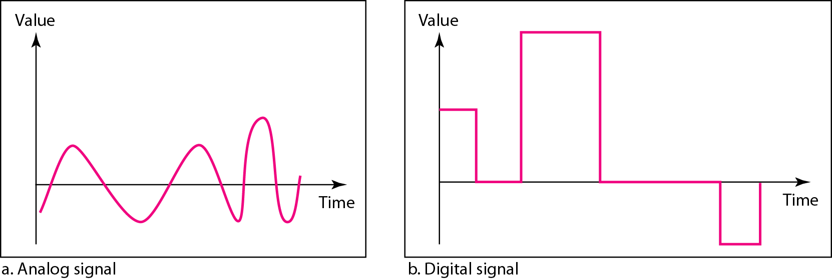
Comparison of analog and digital signals
Dr. Vivek Rajpoot
Unit-2

Slide 5
Time domain concepts
Continuous signal
Infinite number of points at any given time
Discrete signal
Finite number of points at any given time; maintains a constant level then changes to another constant level
Periodic signal
Pattern repeated over time
Aperiodic (non-periodic) signal
Pattern not repeated over time
Dr. Vivek Rajpoot
Unit-2

Slide 6
Time domain concepts
In data communications, we commonly use periodic analog signals and nonperiodic digital signals.
Periodic analog signals can be classified as simple (Singletone) or composite.
A simple periodic analog signal, a sine wave, cannot be decomposed into simpler signals.
A composite periodic analog signal is composed of multiple sine waves.
All signals are composed of three properties:
Frequency: No of cycles per second.
Amplitude: Amplitude of a signal refers to the height of the signal
Phase: Phase describes the position of the waveform relative to time 0.
“A single-frequency sine wave is not useful in data communications we need to send a composite signal, a signal made of many simple sine waves”
Dr. Vivek Rajpoot
Unit-2

Slide 7
Fourier Analysis
Fourier Analysis – any composite signal is a combination of simple sine waves with different frequencies and amplitudes
These simple sine waves are also called harmonics.
Fourier Analysis helps us in finding the different frequency components of the signal, along with their respective weightages.
Fourier analysis also helps in the reverse process, namely, if the frequency components of an electromagnetic signal are known, along with their weights, then it enables us to get the time domain representation of the signal.
Dr. Vivek Rajpoot
Unit-2

Slide 8
Digital Signals
In addition to being represented by an analog signal, information can also be represented by a digital signal. For example, a 1 can be encoded as a positive voltage and a 0 as zero voltage. A digital signal can have more than two levels. In this case, we can send more than 1 bit for each level.
Bit Rate: No of bits transmitted per second
Bit rate focuses on computer efficiency.
Bit Interval: Time required to send one bit is called bit interval.
Baud Rate: No of signal levels per second.
Bit rate = Baud rate * the number of bit per baud
Baud rate focuses on data transmission.
Baud Rate = Bit rate / the number of bit per baud
Dr. Vivek Rajpoot
Unit-2

Slide 9
Data Rate Limits
A very important consideration in data communications is how fast we can send data, in bits per second, over a channel. Data rate depends on three factors:
1. The bandwidth available
2. The level of the signals we use
3. The quality of the channel (the level of noise)
Data rate can be calculated using two theoretical formulae:
Nyquist Theorem– for noiseless channel
Shannon’s Capacity Theorem – for noisy channel
Dr. Vivek Rajpoot
Unit-2

Slide 10
Nyquist Theorem
Nyquist gives the upper bound for the bit rate of a transmission system by calculating the bit rate directly from the number of bits in a symbol (or signal levels) and the bandwidth of the system (assuming 2 symbols/per cycle and first harmonic).
Nyquist bit rate proved that the transmission capacity of even a perfect channel with no noise has a maximum limit.
Nyquist theorem states that for a noiseless channel:
C = 2 B log₂2^{n}
C= capacity in bps
B = bandwidth in Hz
n= No of Levels
Dr. Vivek Rajpoot
Unit-2

Slide 11
Example on Nyquist Theorem
Q.1: Consider a noiseless channel with a bandwidth of 3000 Hz transmitting a signal with two signal levels. What is The maximum bit rate?
Q.2: Consider the same noiseless channel transmitting a signal with four signal levels (for each level, we send 2 bits). What is The maximum bit rate?
Q.3: We need to send 265 kbps over a noiseless channel with a bandwidth of 20 kHz. How many signal levels do we need?
Dr. Vivek Rajpoot
Unit-2

Slide 12
Example on Nyquist Theorem
A.1:
A.2:
A.3:
Dr. Vivek Rajpoot
Unit-2

Slide 13
Shannon’s Theorem
Shannon’s theorem gives the capacity of a system in the presence of noise. Noise can be of various types like thermal noise, impulse noise, cross-talks etc.
Capacity = Bandwidth × log2( 1+SNR )
Capacity is the maximum data rate of the channel in bps
Bandwidth is the bandwidth of the channel
SNR is the signal – to – noise ratio
Dr. Vivek Rajpoot
Unit-2

Slide 14
Example on Shannon’s Theorem
Q.1: Consider an extremely noisy channel in which the value of the signal-to-noise ratio is almost zero. In other words, the noise is so strong that the signal is faint. For this channel What is the capacity C?
Q.2: We can calculate the theoretical highest bit rate of a regular telephone line. A telephone line normally has a bandwidth of 3000. The signal-to-noise ratio is usually 3162. For this channel What is the capacity?
Dr. Vivek Rajpoot
Unit-2

Slide 15
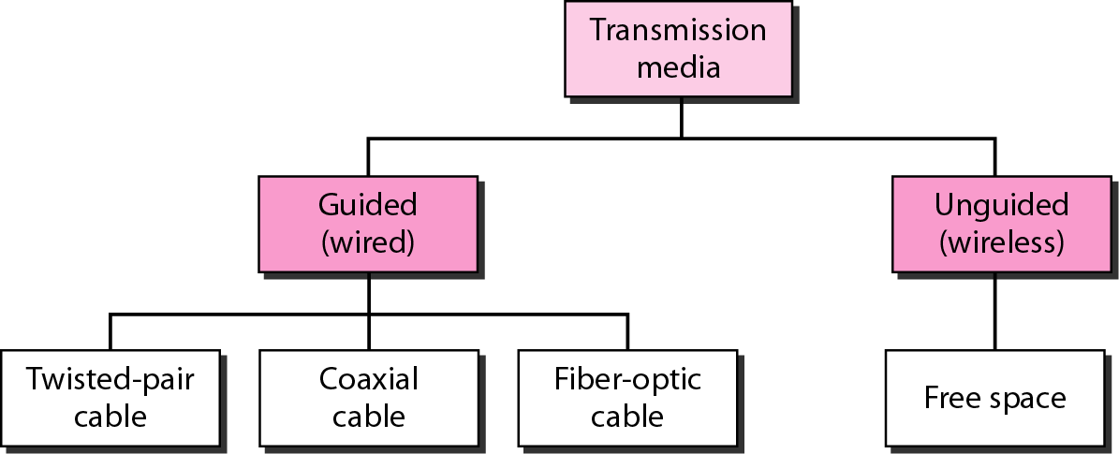
Transmission Media
Located below the physical layer & directly controlled by the physical layer
Types: Guided Media- It provide a physical medium from one device to another, include twisted-pair cable, coaxial cable, and fiber-optic cable.
Wireless: No physical connection is needed.
Dr. Vivek Rajpoot
Unit-2

Slide 16
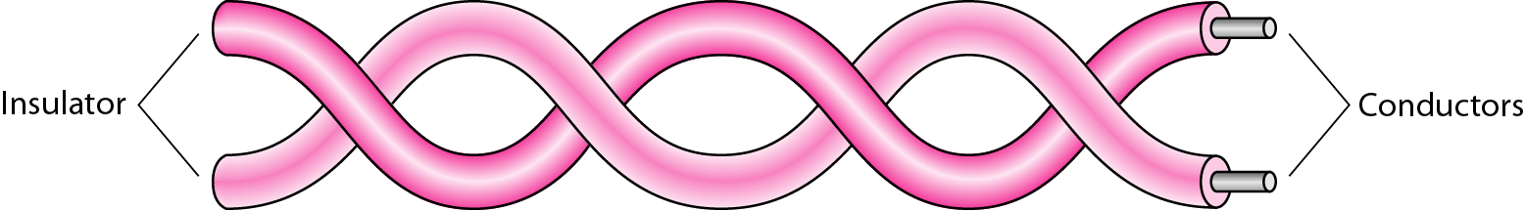
1.Twisted-Pair Cable
Use metallic (copper) conductors to transport signals in the form of current
One of the wire used to carry signal and the other as a ground. The receiver uses the difference between the two.
If the two wires are parallel, the effect of interference noise and crosstalk is big
Twisting the pair of wire balance the effect of unwanted signal and reduce it.
The number of twists per unit of length effects on the quality of the cable.
Dr. Vivek Rajpoot
Unit-2

Slide 17
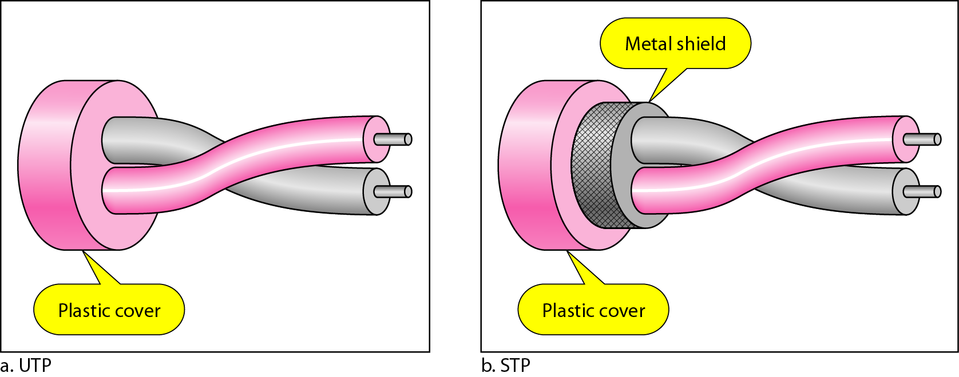
Unshielded versus Shielded Twisted–pair cable
Metal shield in STP improve the quality of cable by preventing the penetration of noise or crosstalk but cable bulkier and more expensive.
Applications of Twisted pair
1. telephone lines to provide voice and data channels (local loop)
2. DSL lines are used by telephone companies to provide high-data-rate connections
3. Local area networks, such as 10-base-T and 100base-T
Dr. Vivek Rajpoot
Unit-2

Slide 18
Categories of unshielded twisted-pair cables
Dr. Vivek Rajpoot
Unit-2

Slide 19
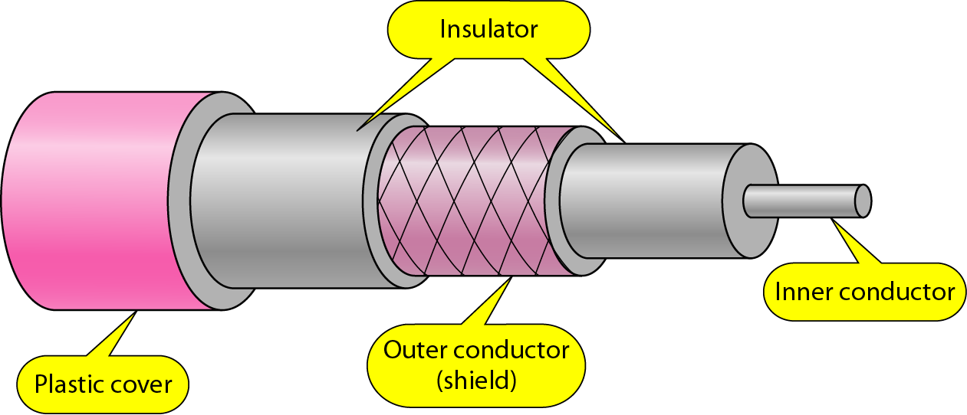
Coaxial (Coax) cable
It carries signals of higher frequency ranges than those in Twisted pair cable.
Instead of having two wires, coax has a central core conductor of solid or stranded wire (usually copper) enclosed in an insulating sheath.
It encased in an outer conductor of metal foil.
The outer conductor serves both as a shield against noise and as second conductor and complete the circuit.
Outer conductor is also enclosed in an insulating sheath, and the whole cable is protected by a plastic cover
Dr. Vivek Rajpoot
Unit-2

Slide 20
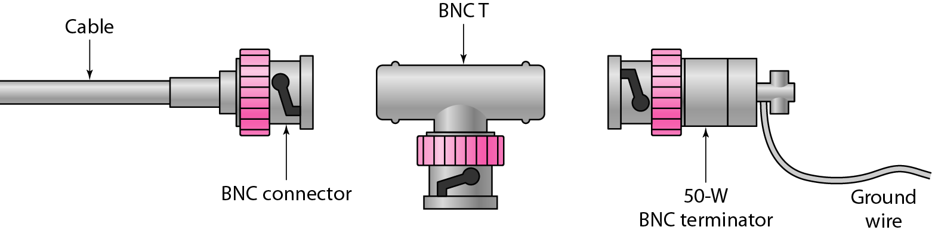
Applications of Coaxial Cable
Applications: 1. Analog telephone network (Single cable can carry 10,000 voice signals, later used in Digital telephone networks to carry 600Mbps)
2. Cable TV network: Cable TV use RG-59
3. Traditional Ethernet LANs. Thin Ethernet: 10-base-2, uses RG-58 coax, data rate 10 Mbps, range 185m. Thick Ethernet: 10-base-5, uses RG-11, Data rate10 Mbps, rang of 500 m.
BNC connectors are used to connect coaxial cable to devices.
1. BMC: Used in TV
2. BNCT: Ethernet network
3. BNC terminator: End of the
cable to prevent the reflection
of the signal.
Dr. Vivek Rajpoot
Unit-2

Slide 21
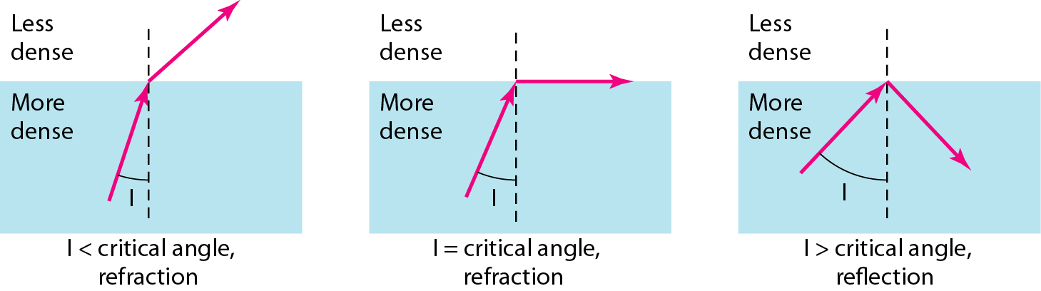
Fiber-Optic Cable
Is made of glass or plastic and transmit signals in the form of light
Light travels in a straight line as long as it is moving through a single uniform substance. If a ray of light traveling through one substance enters another substance of different density, the ray change direction as shown:
Dr. Vivek Rajpoot
Unit-2

Slide 22
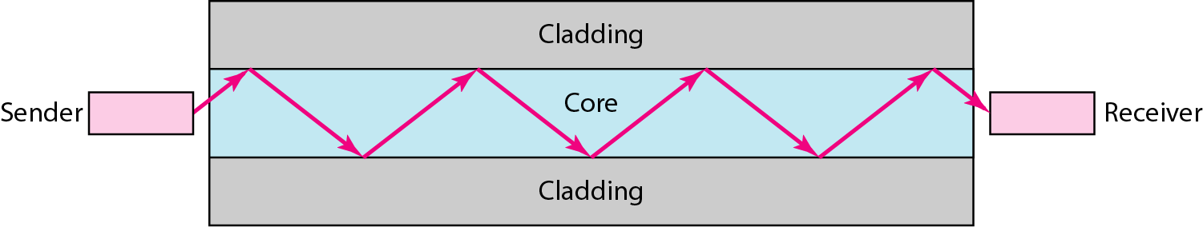
Fiber-Optic Cable
I is angle of incidence: the angle the ray makes with line perpendicular to the interface between the two substances
Critical angle: property of substance, its value differs from one substance to another.
Fiber Optical : uses reflection to guide light through a channel. A glass or plastic core is surrounded by a cladding of less dense glass or plastic.
If the angle of incidence I is less than the critical angle, the ray refracts and moves closer to the surface. If the angle of incidence is equal to the critical angle, the light bends along the interface. If the angle is greater than the critical angle, the ray reflects (makes a turn) and travels again in the denser substance.
Dr. Vivek Rajpoot
Unit-2

Slide 23
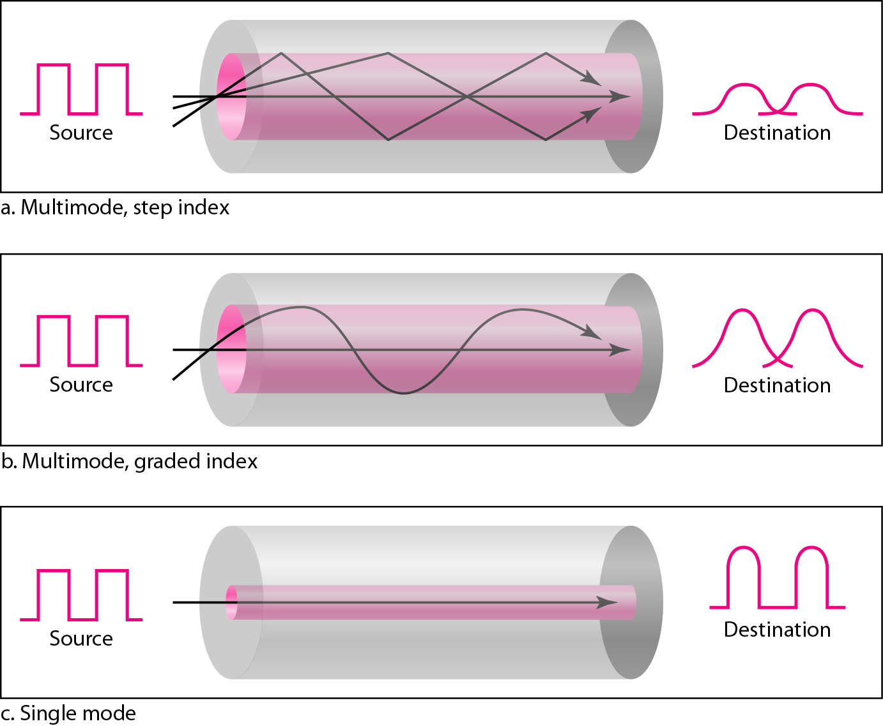
Fiber-Optic Cable
Modes: 1 Single Mode
2 Multi Mode (Step Index Fiber, Graded Index Fiber)
Dr. Vivek Rajpoot
Unit-2

Slide 24
Fiber-Optic Features
Advantages:
Higher Bandwidth, Less signal attenuation and Immunity to EM interference (noise).
Resistance to corrosive materials. Glass is more resistance to corrosive material
Light weight. Fiber cables are much lighter than copper cables
Greater immunity to tapping: copper cables create antenna effects that can easily tapped
Applications:
Cable TV network: hybrid network use a combination of optical fiber and coax cable.
Local Area Networks such as 100base-FX(fast Ethernet) and 1000base-X LANs.
Backbone networks because its wide bandwidth
Disadvantages: Installation and maintenance, Unidirectional light propagation (For bidirectional use tow cables are needed), Cost (cable and the interfaces are more expensive)
Dr. Vivek Rajpoot
Unit-2

Slide 25
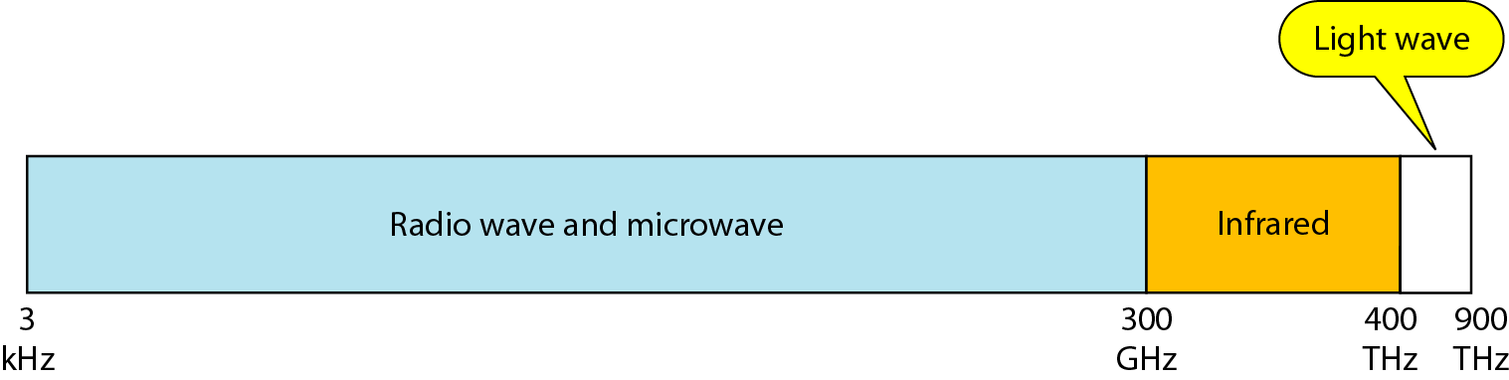
Wireless Media
Wireless media transport EM waves without using a physical conductor
Spectrum:
Dr. Vivek Rajpoot
Unit-2

Slide 26
Wireless Media
1.Ground Propagation:
Radio waves travel through the lowest portion of the atmosphere, hugging the earth.
The low frequency signal follow the curvature of the planet.
Distance depends on the amount of the power.
2.Sky Propagation:
Higher frequency radio radiate upward into the ionosphere where they are reflected back to the earth.
Sky propagation allow for greater distance with lower power output.
3.line-of-sight Propagation:
Very high frequency signals are transmitted in straight lines directly from antenna to antenna.
Dr. Vivek Rajpoot
Unit-2

Slide 27
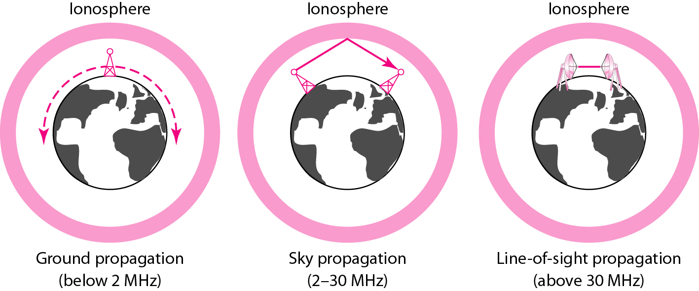
Wireless Media
Dr. Vivek Rajpoot
Unit-2

Slide 28
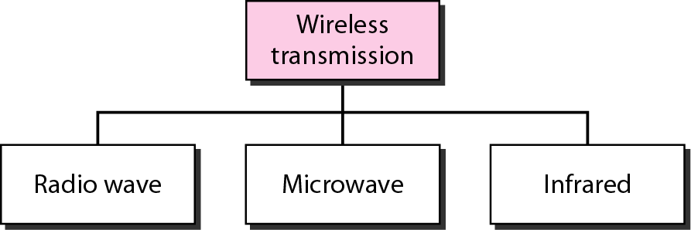
Wireless Transmission Wave
Dr. Vivek Rajpoot
Unit-2

Slide 29
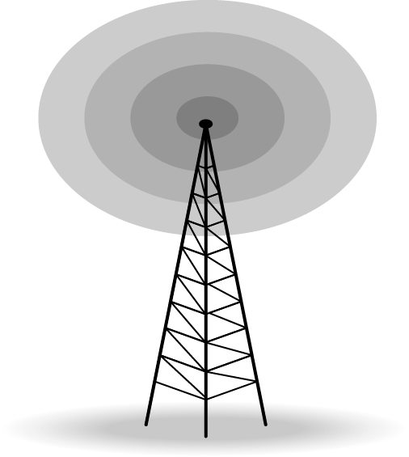
Radio Wave
Although there is no clear-cut demarcation between radio waves and microwaves, electromagnetic waves ranging in frequencies between 3 kHz and 1 GHz are normally called radio waves; waves ranging in frequencies between 1 and 300 GHz are called microwaves. However, the behavior of the waves, rather than the frequencies, is a better criterion for classification.
Between 3 KHz – 1 GHz.
Radio waves use omnidirectional antenna.
Radio waves used in radio and television.
Sky Propagation. This makes radio waves a good candidate for long-distance broadcasting such as AM radio.
Dr. Vivek Rajpoot
Unit-2

Slide 30
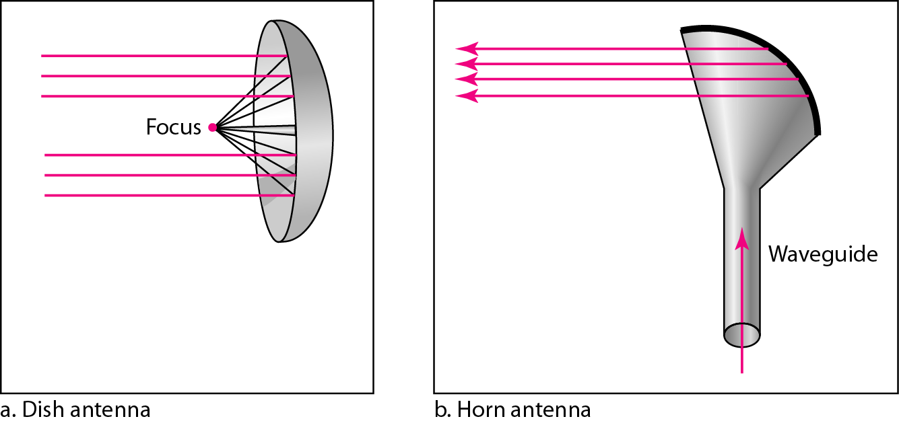
Microwaves
Microwaves are used for unicast communication such as cellular telephones, satellite networks, and wireless LANs.
Higher frequency ranges can penetrate walls.
Use directional antennas - point to point line of sight communications.
Dr. Vivek Rajpoot
Unit-2

Slide 31
Infrared signals
Frequencies from 300 GHz to 400 THz (wavelengths from 1 mm to 770 nm), can be used for short-range communication.
IR having high frequencies, cannot penetrate walls. This advantageous characteristic prevents interference between one system and another; a short-range communication system in one room cannot be affected by another system in the next room.
When we use remote control, the IR of remote do not interfere by neighbors remote.
This same characteristic makes IR signals useless for long-range communication.
In addition, we cannot use infrared waves outside a building because the sun's rays contain infrared waves that can interfere with the communication.
Used for short-range communication.
Very common with remote control devices, but can also be used for device-to-device transfers, such as PDA to computer.
Line-of-sight propagation.
Dr. Vivek Rajpoot
Unit-2

Slide 32
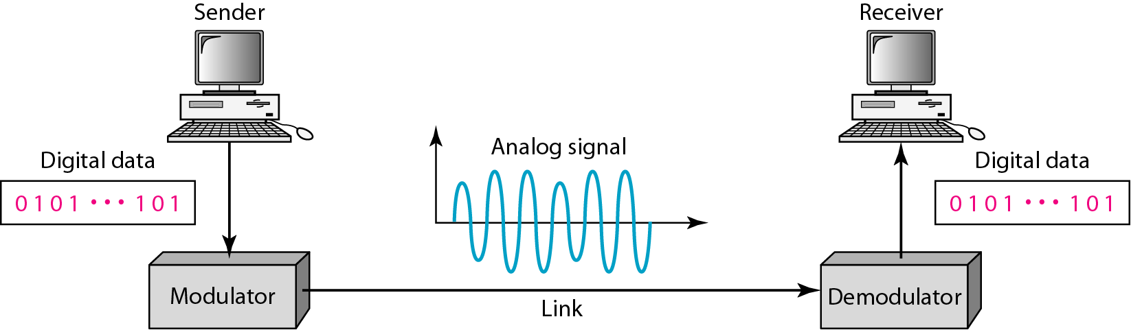
Digital-to-analog Conversion
D to A conversion is a process of changing characteristics of an analog signal based on the information in digital data. i.e. Digital data needs to be carried on an analog signal.
Analog carrier signal is manipulated to uniquely identify the digital data being carried.
Carrier signal : the sending device produces a high-frequency signal that acts as a base for the information signal. This base signal is called the carrier signal or carrier frequency.
Sine wave is defined by three characteristics (amplitude, frequency, and phase) ⇒ digital data (binary 0 and 1) can be represented by varying any of the three.
Dr. Vivek Rajpoot
Unit-2

Slide 33
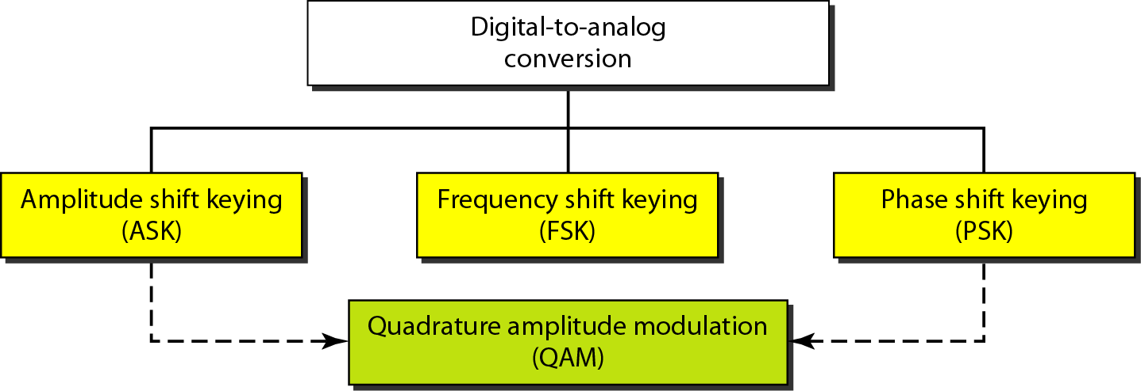
Types of digital-to-analog conversion
ASK:
Amplitude of the carrier signal is varied to represent binary 1 or 0
Both frequency and phase remain constant while the amplitude changes.
Dr. Vivek Rajpoot
Unit-2

Slide 34
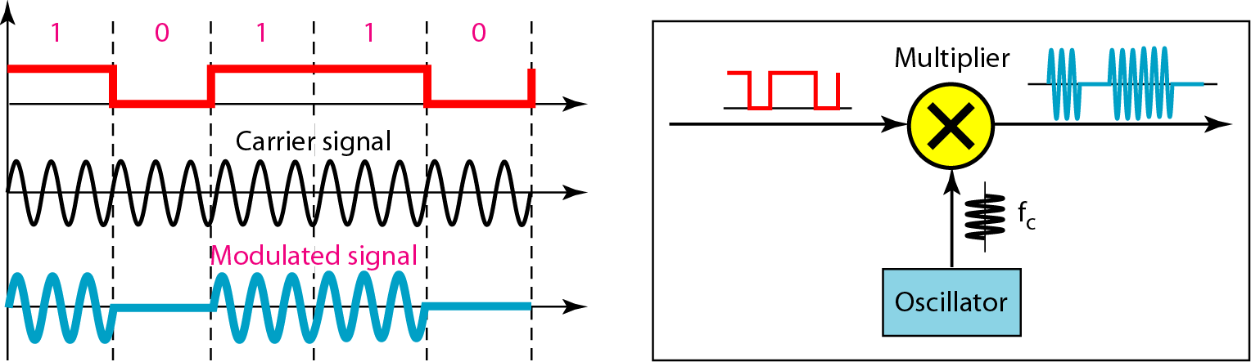
ASK
Advantage: simplicity
Disadvantage: ASK is very susceptible to noise interference – noise usually (only) affects the amplitude, therefore ASK is the modulation technique most affected by noise
Bandwidth of ASK: The bandwidth B of ASK is proportional to the signal rate S.
B = (1+d)S
‘d’ is constant lies between 0 and 1.
Dr. Vivek Rajpoot
Unit-2

Slide 35
Example on ASK
We have an available bandwidth of 100 kHz which spans from 200 to 300 kHz. What are the carrier frequency and the bit rate if we modulated our data by using ASK with d = 1?
B = (1+d)S
Solution
The middle of the bandwidth is located at 250 kHz. This means that our carrier frequency can be at fc = 250 kHz. We can use the formula for bandwidth to find the bit rate (with d = 1 and r = 1)
Dr. Vivek Rajpoot
Unit-2

Slide 36
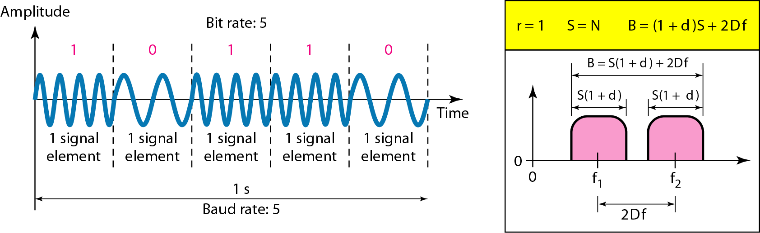
Frequency Shift Keying
The digital data stream changes the frequency of the carrier signal, f_{c}.
For example, a “1” could be represented by f₁=f_{c} +Δf, and a “0” could be represented by f₂=f_{c}-Δf.
Dr. Vivek Rajpoot
Unit-2

Slide 37
Bandwidth in FSK
If the difference between the two frequencies (f₁ and f₂) is 2Δf, then the required BW B will be:
B = (1+d)xS +2Δf
We have an available bandwidth of 100 kHz which spans from 200 to 300 kHz. What should be the carrier frequency and the bit rate if we modulated our data by using FSK with d = 1?
Solution
This problem is similar to Example but we are modulating by using FSK. The midpoint of the band is at 250 kHz. We choose 2Δf to be 50 kHz; this means
Dr. Vivek Rajpoot
Unit-2

Slide 38
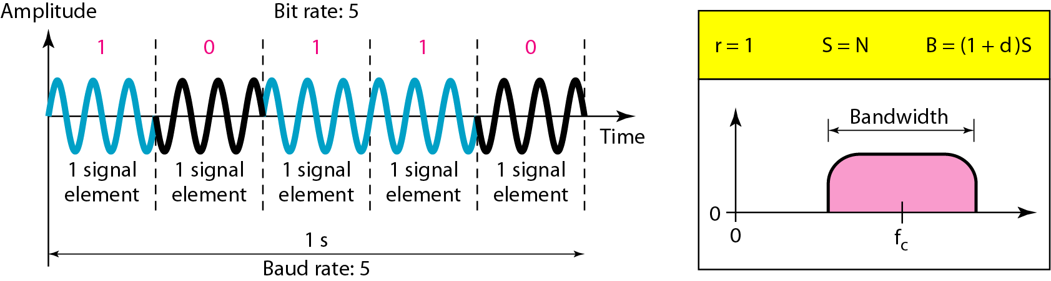
PSK
In PSK, the phase of the carrier is varied to represent two or more different signal elements. Both peak amplitude and frequency remain constant.
The bandwidth requirement, B is:
B = (1+d)xS
PSK is much more robust than ASK as it is not that vulnerable to noise, which changes amplitude of the signal.
In BPSK, two signal elements one with phase of 0°, & other with 180° shared.
Dr. Vivek Rajpoot
Unit-2

Slide 39
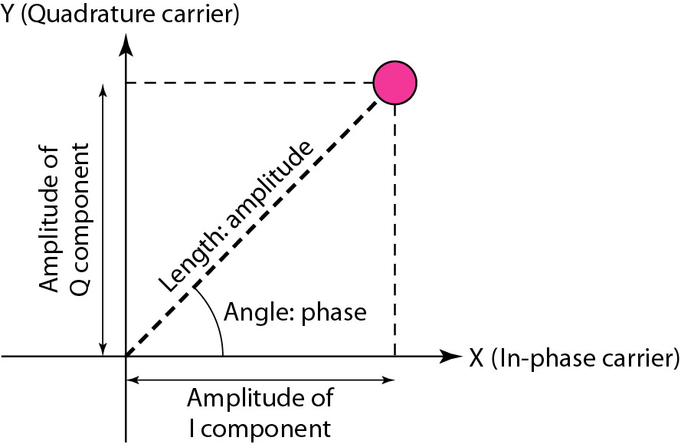
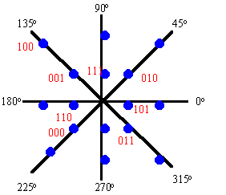
Quadrature Amplitude Modulation QAM
QAM is a combination of ASK and PSK.
In QAM signal two carriers shifted in phase by 90 degrees are modulated & the resultant output consists of both amplitude and phase variations.
One popular technique is QAM involves splitting the signal into eight different phases, and two different amplitude for a total of 16 different possible values
A constellation diagram helps us to define the amplitude and phase of a signal when we are using two carriers, one in quadrature of the other.
X-axis represents in-phase carrier and the Y-axis represents quadrature carrier.
Dr. Vivek Rajpoot
Unit-2

Slide 40
Advantages and Disadvantages
Advantages:
The major benefit of QAM modulation variants is efficient usage of bandwidth. This is due to the fact that QAM represent more number of bits per carrier.
Disadvantages:
QAM modulation is more susceptible to the noise. Due to this QAM receiver is more complex compare to receivers of other modulation types.
Dr. Vivek Rajpoot
Unit-2

Slide 41
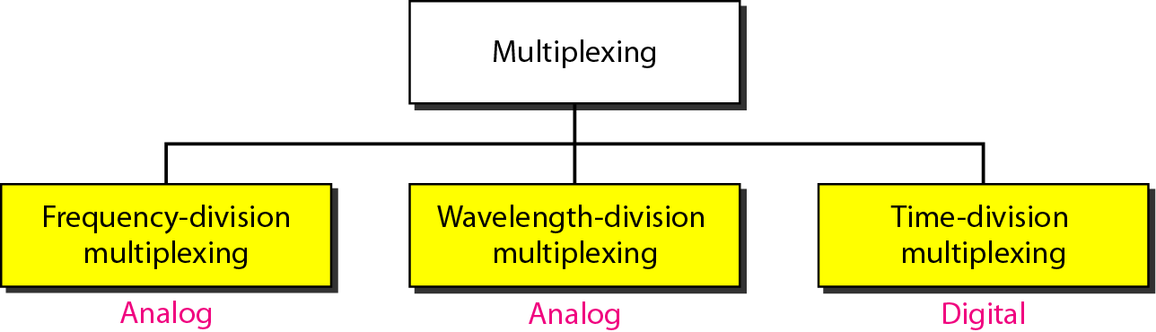
Multiplexing
Whenever the bandwidth of a medium linking two devices is greater than the bandwidth needs of the devices, the link can be shared. Multiplexing is the set of techniques that allows the (simultaneous) transmission of multiple signals across a single data link. As data and telecommunications use increases, so does traffic.
Bandwidth utilization is the wise use of available bandwidth to achieve specific goals.
Dr. Vivek Rajpoot
Unit-2

Slide 42
Frequency-division multiplexing (FDM)
Frequency-division multiplexing (FDM) is an analog technique that can be applied when the bandwidth of a link (in hertz) is greater than the combined bandwidths of the signals to be transmitted.
signals generated by each sending device modulate different carrier frequencies. These modulated signals are then combined into a single composite signal that can be transported by the link.
Channels can be separated by strips of unused bandwidth-guard bands-to prevent signals from overlapping
FDM to be an analog multiplexing technique; however, this does not mean that FDM cannot be used to combine sources sending digital signals. A digital signal can be converted to an analog signal before FDM is used to multiplex them.
Dr. Vivek Rajpoot
Unit-2

Slide 43
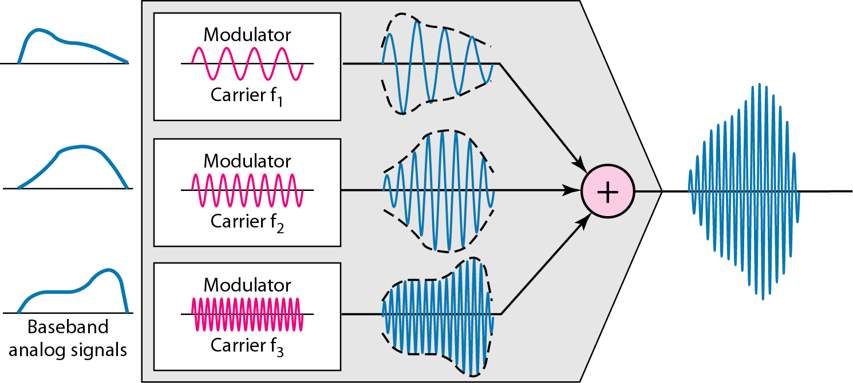
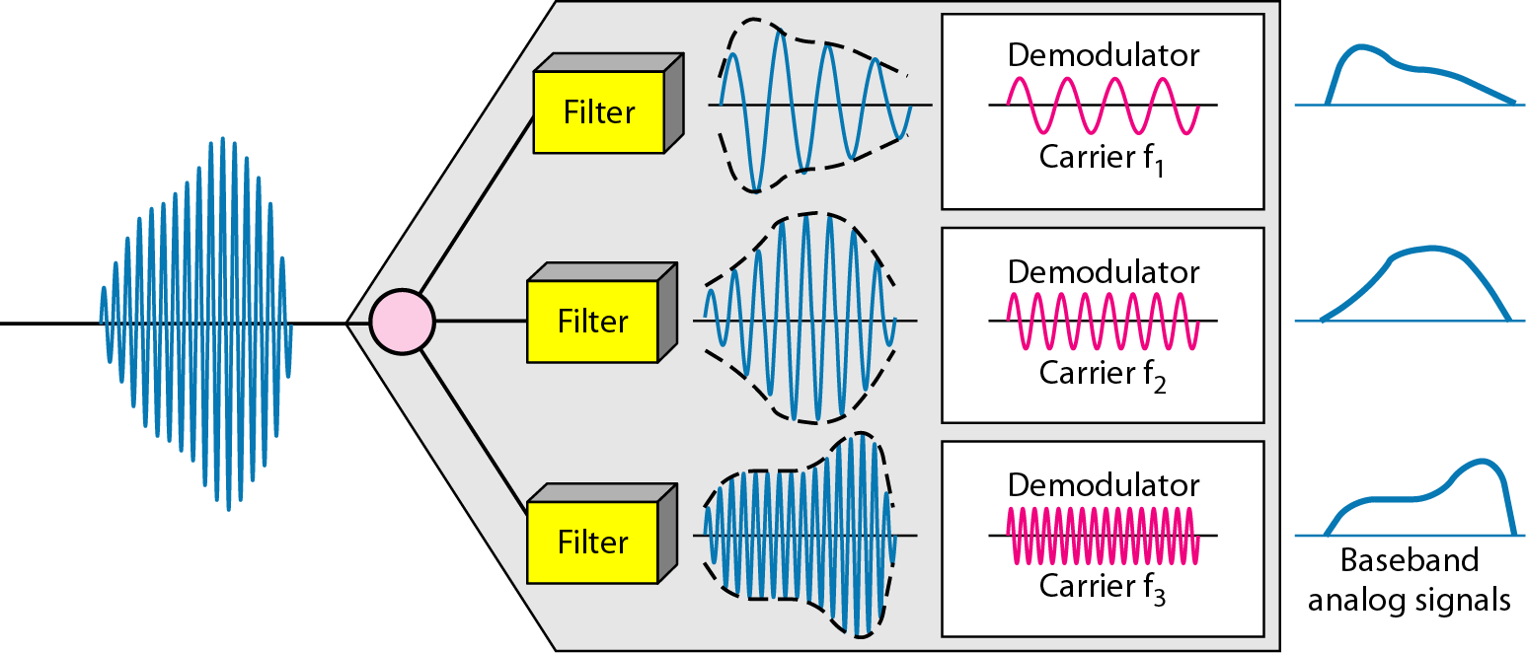
Frequency-division multiplexing (FDM)
Each source generates a signal of a similar frequency range
Inside the multiplexer, these similar signals modulates different carrier frequencies . The resulting modulated signals are then combined into a single composite signal that is sent out over a media link that has enough bandwidth to accommodate it.
Demultiplexer uses a series of filters to decompose the multiplexed signal into its constituent signals. The individual signals are then passed to a demodulator that separates them from their carriers and passes them to the output lines
Dr. Vivek Rajpoot
Unit-2

Slide 44
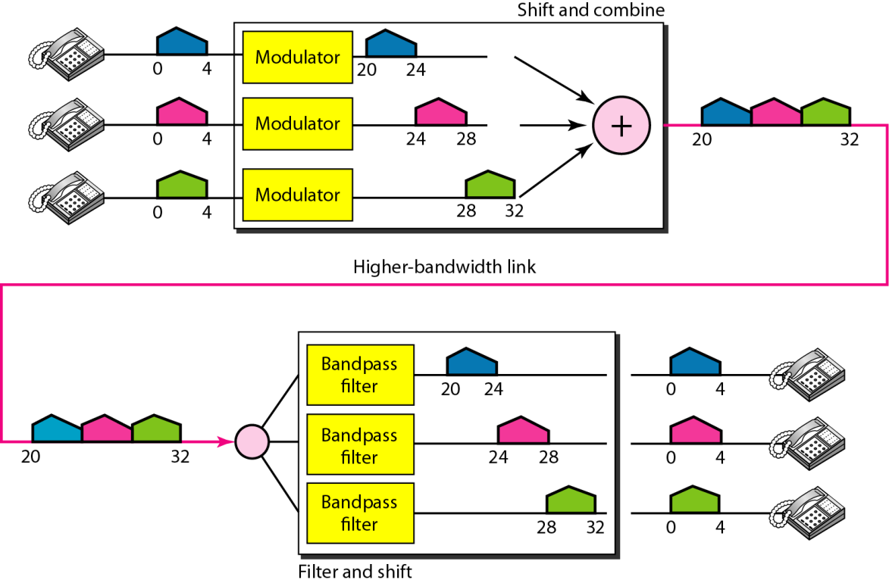
Example of FDM
Assume that a voice channel occupies a bandwidth of 4 kHz. We need to combine three voice channels into a link with a bandwidth of 12 kHz, from 20 to 32 kHz. Show the configuration, using the frequency domain. Assume there are no guard bands.
Dr. Vivek Rajpoot
Unit-2

Slide 45
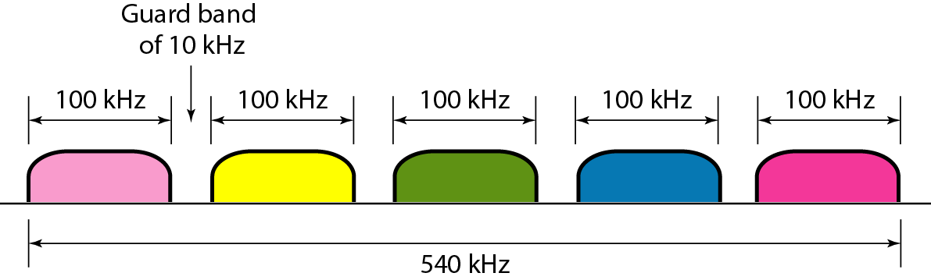
Example of FDM
Five channels, each with a 100-kHz bandwidth, are to be multiplexed together. What is the minimum bandwidth of the link if there is a need for a guard band of 10 kHz between the channels to prevent interference?
Dr. Vivek Rajpoot
Unit-2

Slide 46
Applications of FDM
Very common application of FDM is AM and FM radio broadcasting.
A special band from 530 to 1700 kHz is assigned to AM radio. All radio stations need to share this band.
Each AM station needs 10kHz of bandwidth.
FM has a wider band of 88 to 108 MHz because each station needs a bandwidth of 200 kHz.
Another common use of FDM is in television broadcasting. Each TV channel has its own bandwidth of 6 MHz.
The first generation of cellular telephones also uses FDM.
Dr. Vivek Rajpoot
Unit-2

Slide 47
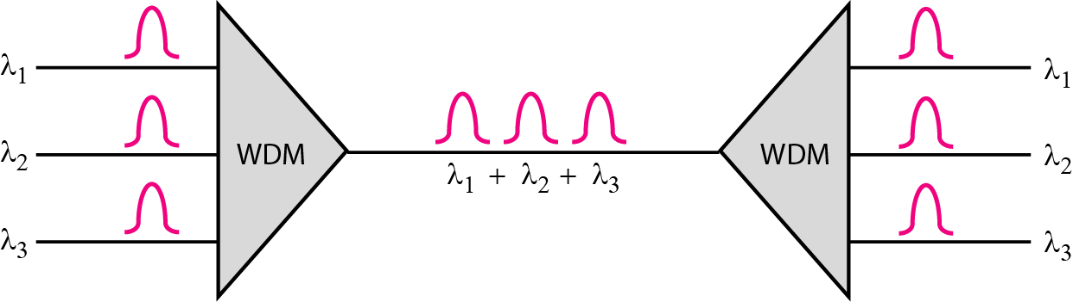
Wavelength-Division Multiplexing
Wavelength-division multiplexing (WDM) is designed to use the high-data-rate capability of fiber-optic cable.
Using a fiber-optic cable for one single line wastes the available bandwidth. Multiplexing allows us to combine several lines into one.
WDM is conceptually the same as FDM, except that the multiplexing and demultiplexing involve optical signals transmitted through fiber-optic channels. The idea is the same: We are combining different signals of different frequencies.
Dr. Vivek Rajpoot
Unit-2

Slide 48
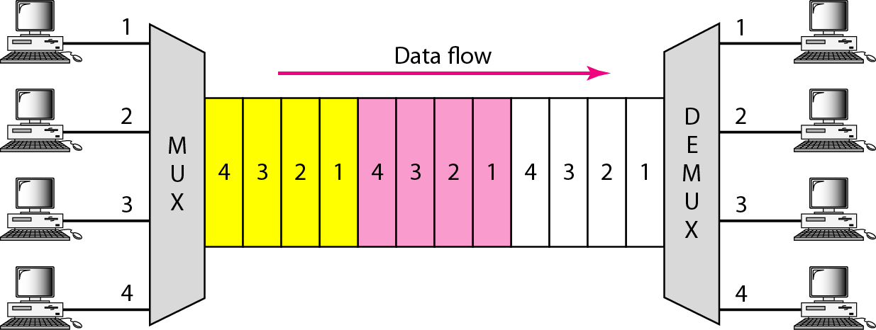
Time-Division Multiplexing
Time-division multiplexing (TDM) is a digital process that allows several connections to share the high bandwidth of a line Instead of sharing a porion of the bandwidth as in FDM, time is shared.
TDM is a digital multiplexing technique for combining several low-rate channels into one high-rate one.
Digital data from different sources are combined into one timeshared link.
Dr. Vivek Rajpoot
Unit-2

Slide 49
Types of TDM
1.Synchronous TDM
2.Statistical TDM
Synchronous TDM: each input connection has an allotment in the output even if it is not sending data.
Time Slots and Frames:
In synchronous TDM, the data flow of each input connection is divided into units, where each input occupies one input time slot. A unit can be 1 bit, one character, or one block of data.
In synchronous TDM, a round of data units from each input connection is collected into a frame.
If we have n connections, a frame is divided into n time slots and one slot is allocated for each unit, one for each input line.
Time slots are grouped into frames. A frame consists of one complete cycle of time slots, with one slot dedicated to each sending device. In a system with n input lines, each frame has n slots.
Dr. Vivek Rajpoot
Unit-2

Slide 50
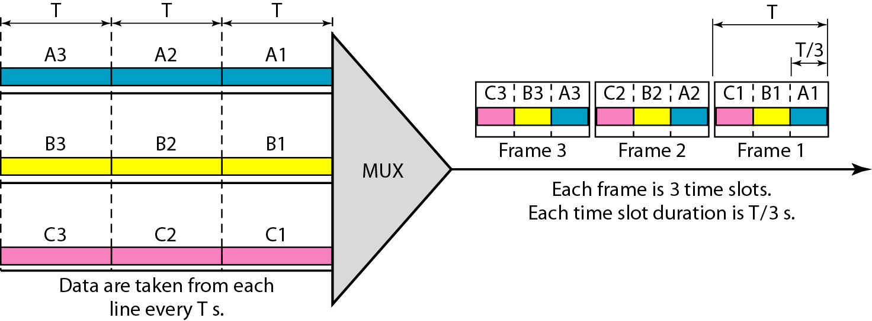
Synchronous TDM
Dr. Vivek Rajpoot
Unit-2

Slide 51
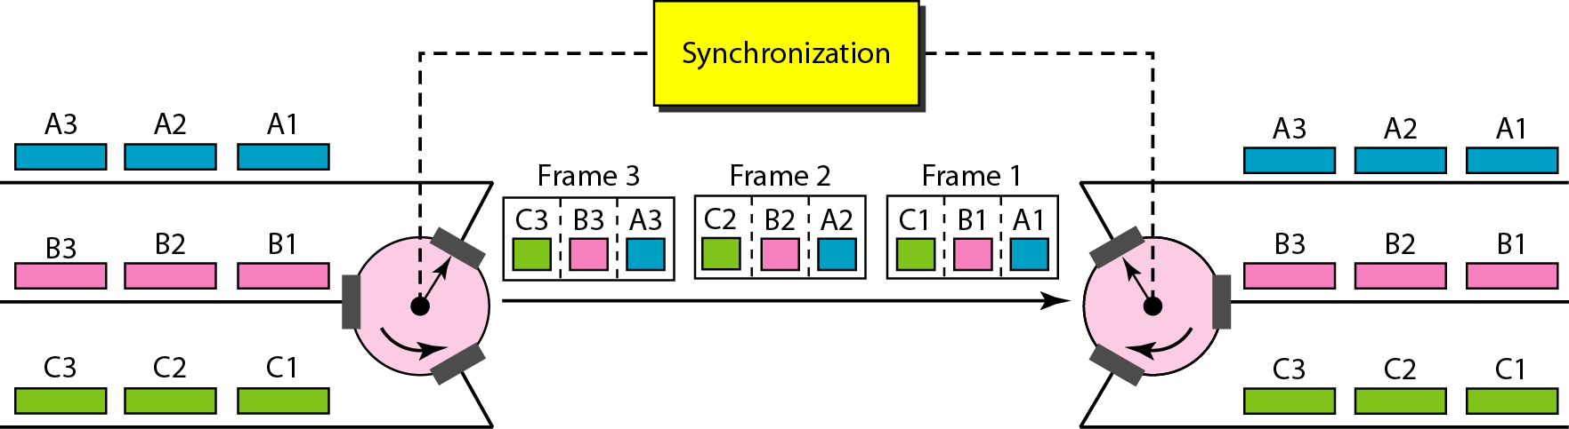
Interleaving in TDM
TDM can be visualized as two fast-rotating switches, one on mux side and other on demux side. The witches are synchronized and rotate at same speed, but in opposite directions.
On the multiplexing side, as the switch opens in front of a connection, that connection has the opportunity to send a unit onto the path. This process is called interleaving.
On the demultiplexing side, as the switch opens in front of a connection, that connection has the opportunity to receive a unit from the path.
Dr. Vivek Rajpoot
Unit-2

Slide 52
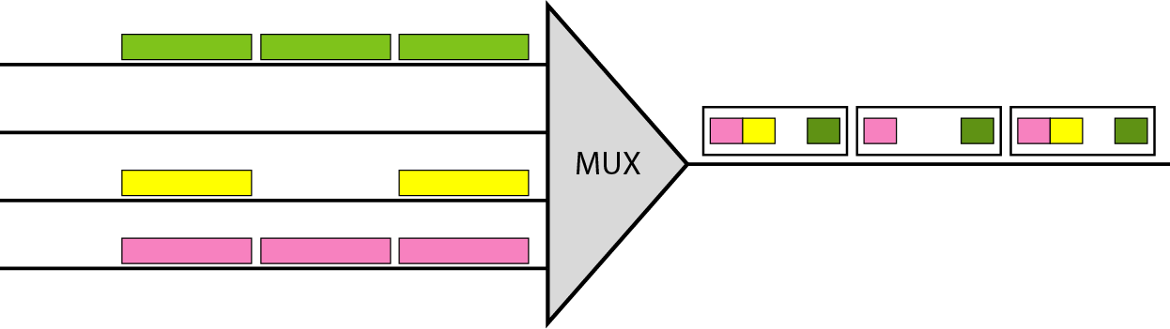
Drawback in TDM
Empty Slots: If a source does not have data to send, the corresponding slot in the output frame is empty.
The first output frame has three slots filled, the second frame has two slots filled, and the third frame has three slots filled.
Dr. Vivek Rajpoot
Unit-2

Slide 53
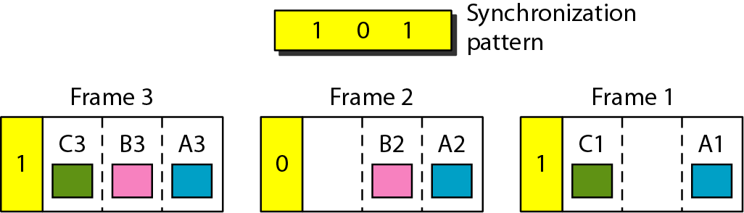
Frame Synchronizing
The implementation of TDM is not as simple as that of FDM. Synchronization between the multiplexer and demultiplexer is a major issue.
If the. multiplexer and the demultiplexer are not synchronized, a bit belonging to one channel may be received by the wrong channel.
one or more synchronization bits are usually added to the beginning of each frame. These bits, called framing bits, follow a pattern, frame to frame, that allows the demultiplexer to synchronize with the incoming stream so that it can separate the time slots accurately.
Dr. Vivek Rajpoot
Unit-2

Slide 54
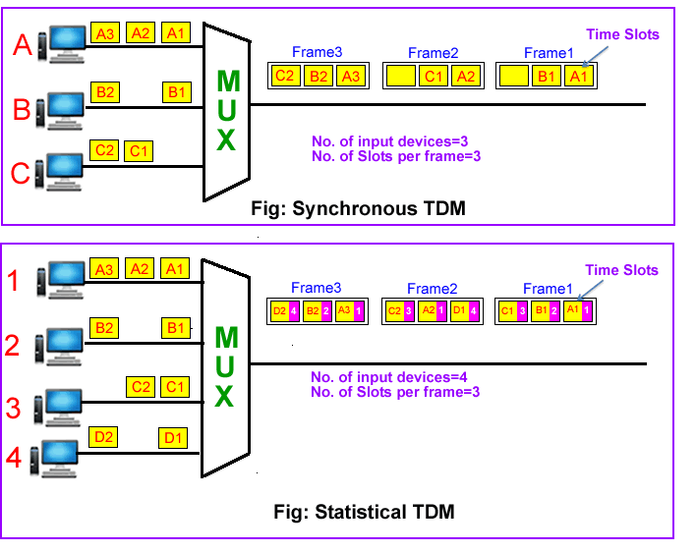
Statistical Time-Division Multiplexing
In synchronous TDM, each input has a reserved slot in the output frame. This can be inefficient if some input lines have no data to send.
In statistical TDM, slots are dynamically allocated to improve bandwidth efficiency.
In statistical multiplexing, the number of slots in each frame is less than the number of input lines. The mux checks each input line in roundrobin fashion; it allocates a slot for an input line if the line has data to send; otherwise, it skips the line and checks the next line.
Dr. Vivek Rajpoot
Unit-2

Slide 55
Advantages of Statistical TDM
Slot Size: Since a slot carries both data and an address in statistical TDM, the ratio of the data size to address size must be reasonable to make transmission efficient.
No Synchronization Bit: There is another difference between synchronous and statistical TDM, but this time it is at the frame level. The frames in statistical TDM need not be synchronized, so we do not need synchronization bits.
Bandwidth: In statistical TDM, the capacity of the link is normally less than the sum of the capacities of each channel.
Dr. Vivek Rajpoot
Unit-2

Slide 56
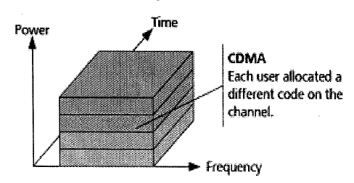
Code Division Multiple Access
When CDM is used to allow multiple signals from multiple users to share a common communication channel, the technology is called CDMA.
CDM is a multiplexing that uses spread spectrum technique.
In spread spectrum the a narrow band signal is spread over a larger band of frequency or across multiple channels via division.
Each group of users is given a shared code and individual conversations are encoded in a digital sequence. Data is available on the shared channel, but only those users associated with a particular code can access the data.
Dr. Vivek Rajpoot
Unit-2

Slide 57
Code Division Multiple Access
Each station is assigned a unique code. The codes have the following two properties (orthogonal code)
If code of one station is multiplied by code of another station, it yields 0.
If code of one station is multiplied by itself, it yields a positive number equal to the number of stations.
Example: Consider that there are four stations w, x, y and z that have codes Cw , Cx, Cy and Cz and transmit data Dw , Dx, Dy and Dz respectively.
Each station multiplies its code with its data and the sum of all the terms is transmitted in the communication channel. (Cw * Dw)+ (Cx * Dx)+ (Cy * Dy)+ (Cz * Dz)
Suppose station z wants to receive data sent by station y. In order to retrieve the data, it will multiply the received data by the code of station y which is Dy.
It is less susceptible to interference.
Communication is very secure.
Dr. Vivek Rajpoot
Unit-2

